Slide 1







OBIB – The Ontology for Biobanking
Biobanking Without Borders, LLC
Release 2017-11-30

Slide 2
OBIB Purpose
Provide standard naming scheme for information collected throughout the life cycle of a biospecimen.
Define the processes, participants, protocols, and other key elements that were involved in generating the biospecimen information.
Enable computer-processable representations of the biospecimen information when encoded in OBIB.

Slide 3
Multi-Institutional Collaboration
Christian J. Stoeckert Jr., David L. Birtwell, Heather Williams, Jie Zheng, University of Pennsylvania, Philadelphia, PA Leidos subcontract
Mathias Brochhausen, University of Arkansas for Medical Sciences, Little Rock, AR
Helena Ellis, Biobanking Without Borders, LLC
Anna Maria Masci, Duke University, Durham, NC
Ping Guan, Helen M Moore, National Cancer Institute, Bethesda, MD
Frank J. Manion, University of Michigan, Ann Arbor, MI
Jihad S. Obeid, Medical University of South Carolina, Charleston, SC
MIABIS 2.0 (Roxana Merino Martinez, Kaisa Silander)
Notes:
Start by acknowledging my collaborators in this multi-institutional collaboration

Slide 4

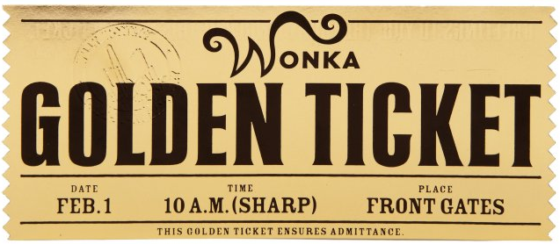
Cohort Identification The Golden Ticket
Criteria: sample type, collection, processing and storage conditions, consent permissions and restrictions, patient demographics, diagnoses, treatments and medications
PROBLEMS
Inconsistent representation of Biobank data
How many SAMPLES available? Multiple meanings for same word.
Single specimen
“Bag” of specimens collected from same person at same time
To collect a specimen
Data in different, disparate systems and schemas
Notes:
What brought us together is the common desire to be able to more effectively perform cohort identification
Need to find patients and associated specimens based on criteria but various problems make this a very long and difficult process

Slide 5
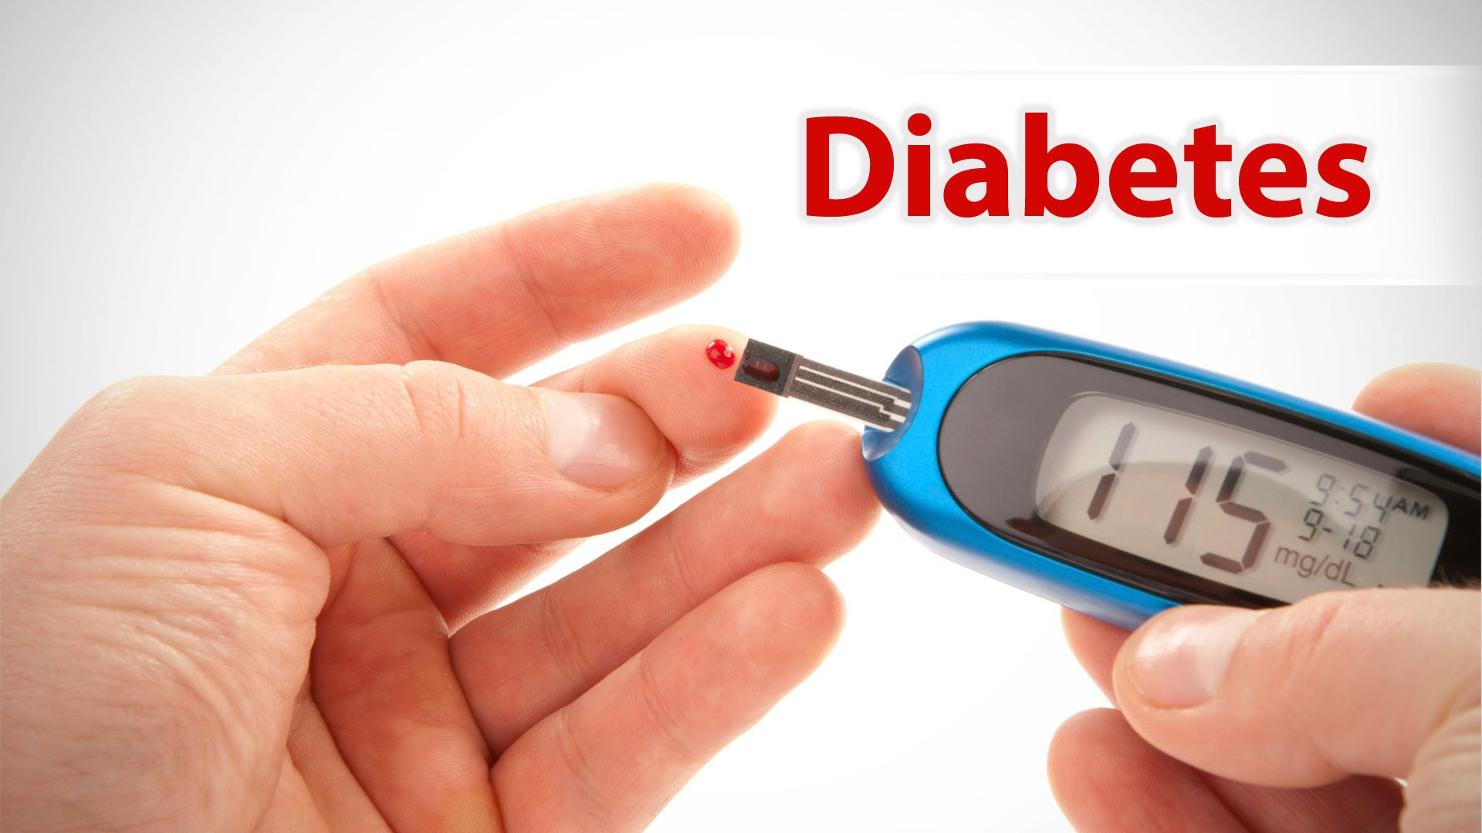
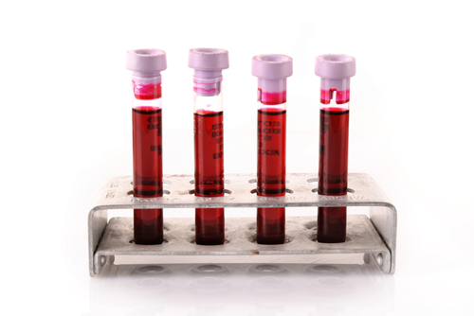

Cohort Identification Challenge at UPenn
Patients (cases) with Type 2 diabetes that have taken a statin 5 to 250 days prior to specimen collection.
Patients (controls) with Type 2 diabetes who have never taken statins.
Match cases and controls on basic demographic data (age, BMI, gender, race) collected at the time of recruitment.
All must have an EDTA blood or DNA specimen and consented to re-contact.
Data in different, disparate databases
These problems can be solved by applying semantic harmonization with an ONTOLOGY
Notes:
Our work is use case driven and this is a representative example that we are trying to address through applying semantic harmonization of the different information collected. This is where the ontology comes in.

Slide 6
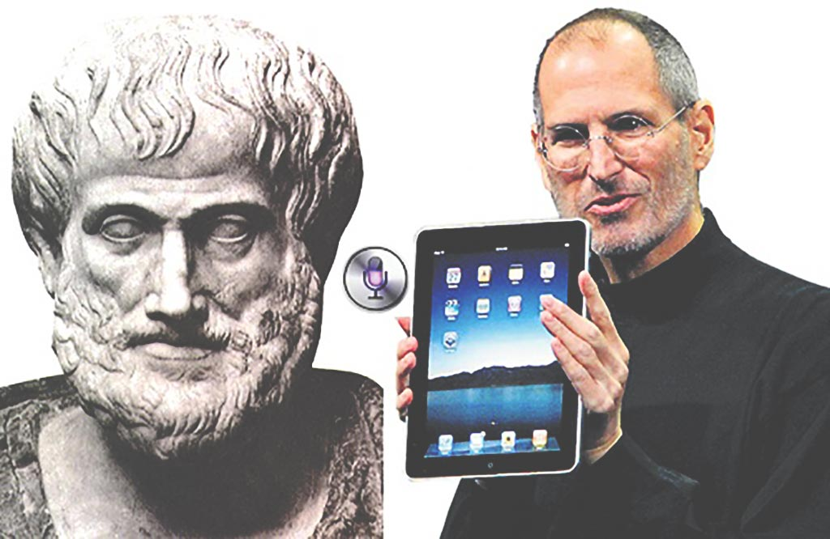
What’s an ontology and why does it matter?
Provide a consistent and unambiguous semantic representation of some domain of interest
life as we know it (philosophers)
biological process (model organism database annotators)
disease outcomes (decision support engineers)
Enables people and machines to make the same logical inferences
Tom Gruber: Siri’s knowledge is represented in a unified modeling system that combines ontologies, inference networks, pattern matching agents, dictionaries, and dialog models.
https://titan.as/siri-new-ipad-steve-jobs-aristotle/

Slide 7

A common language and logic: OBO Foundry Ontologies
OBO = Open Biological and Biomedical Ontologies
Shared design and modeling principles = Interoperable.
Orthogonal – reuse existing terms defined in OBO Foundry ontologies
Over 100 reviewed and candidate ontologies available to cover various biological and clinical domains:
Gene ontology (GO): biological process, molecular function, cell components
Human Disease Ontology (DOID): disease (human)
Ontology for Biomedical Investigations (OBI): all aspects of an investigation
Modeling reality
not database schemas or usage in a specific project.
For more about the OBO Foundry see: http://www.obofoundry.org
Notes:
By ontology I’m referring to a computer processable representation of entities and in this case entities in the biomedical domain.
To build our ontology we following the design and modeling principles of the OBO Foundry.

Slide 8
Main Components and Their Relations in Open Biological and Biomedical Foundry Ontologies
role
investigator role
doctor role
specimen collection
height measurement
weight measurement
BMI calculation
human
blood
specimen
has role
has specified input
material entity
process
has specified output
has specified input
has quality
is about
has specified output
height
weight
information content entity
quality
Last name, first name
6 feet (height)
150 lb (weight)
20.3 (BMI)
is about
Notes:
Central: process
What’s its inputs/outputs
Material entity, collect specimen, blood, blood specimen
Material entity, ICE, assay, blood specimen, glucose concentration in the blood
ICE, ICE, data transformation, glucose concentration in one person, average glucose concentration in a week
Material entity
- Role: patient role, study subject role, reference role
Quality: weight, height
ICE of quality: weight – 50 kg, height 1.6 meter, BMI
ICE of material entity: person name, specimen identifier

Slide 9
Ontology for Biobanking
Developed on existing work- not created de novo
Basic Formal Ontology (BFO)
Ontology for Biomedical Investigations (OBI)
Ontologized MIABIS (OMIABIS)
Informed Consent Ontology (ICO)
Reuse Foundry Ontologies (e.g. Phenotypic Quality, Ontology for General Medical Science)
OBIB is freely available at Github: https://github.com/biobanking/ontology
An application ontology focused specifically on Biobanking domain
Brochhausen M, Zheng J, Birtwell D, Williams H, Masci AM, Ellis HJ, Stoeckert CJ Jr. OBIB-a novel ontology for biobanking. J Biomed Semantics. 2016 May 2;7:23
Notes:
MIABIS = Minimum Information About BIobank data Sharing

Slide 10
= Biobanking
identifier
patient registry data
information
content entity
data item
informed consent form
document
medical record
role
patient role
questionnaire
patient questionnaire
specimen
bone marrow specimen
processed specimen
buffy coat specimen
processed material
freezer
organization
device
material entity
biobank organization
freezer rack
biobank
gross anatomical part
Organism
Reuse of terms in other Foundry Ontologies and newly added biobanking specific terms
diagnostic process
Treatment
planned
process
human subject enrollment
filling form process
specimen collection
material maintenance
specimen freezing
assay
biological
process (GO)
smoking behavior
Notes:
colorful slide illustrates the hierarchy in OBIB and highlights where terms used are from different sources. In green are the ones created for specific biobank needs

Slide 11
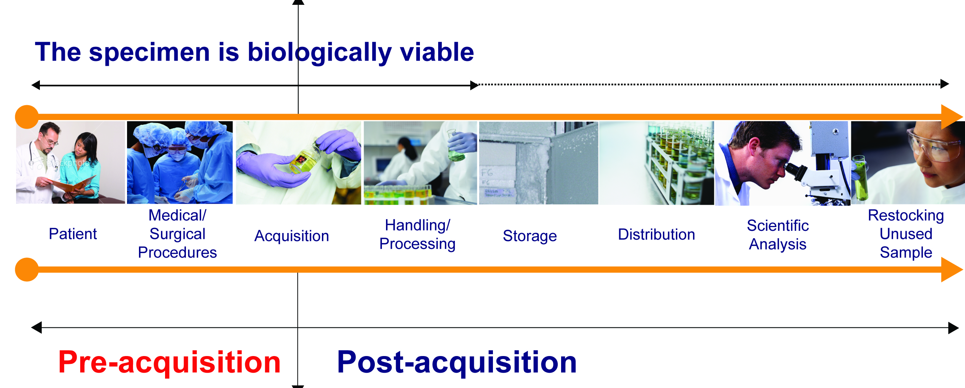
Scope and Purpose
Comprehensive biobanking ontology to enable searching for specimen collections with associated clinical annotation, within and across systems and institutions, that includes essential elements of the biospecimen lifecycle as well as essential elements related to informed consent
Lifecycle of Biospecimen, BBRB of NCI, 2014: Reprinted with permission
Notes:
Modeling approach is to follow the processes that happen in reality during a specimen lifecycle and the inputs and outputs to the processes that connect them

Slide 12


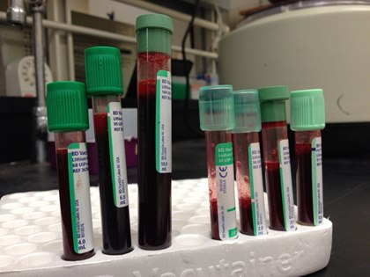
Consent and Collection Processes
Medical/
Surgical
Procedures
Handling/
Processing
Scientific
Analysis
Knowledge
Base
Patient
Acquisition
Storage
Distribution
Human
Consent Process
Participant
Collection Process
Age
Gender
DOB
ICF version
Sample type
Sample volume
Preservative type
Container type
Collection procedure
Date/time signed
Consent to access EMR
Location of process
Consent to donate blood
Person conducting
X
Decline to donate tissue
Notes:
A human is the input to a consent process that has as output a consented participant who is then an input to a specimen collection process. These processes, inputs, outputs, and associated properties, materials, and information are represented in the ontology

Slide 13
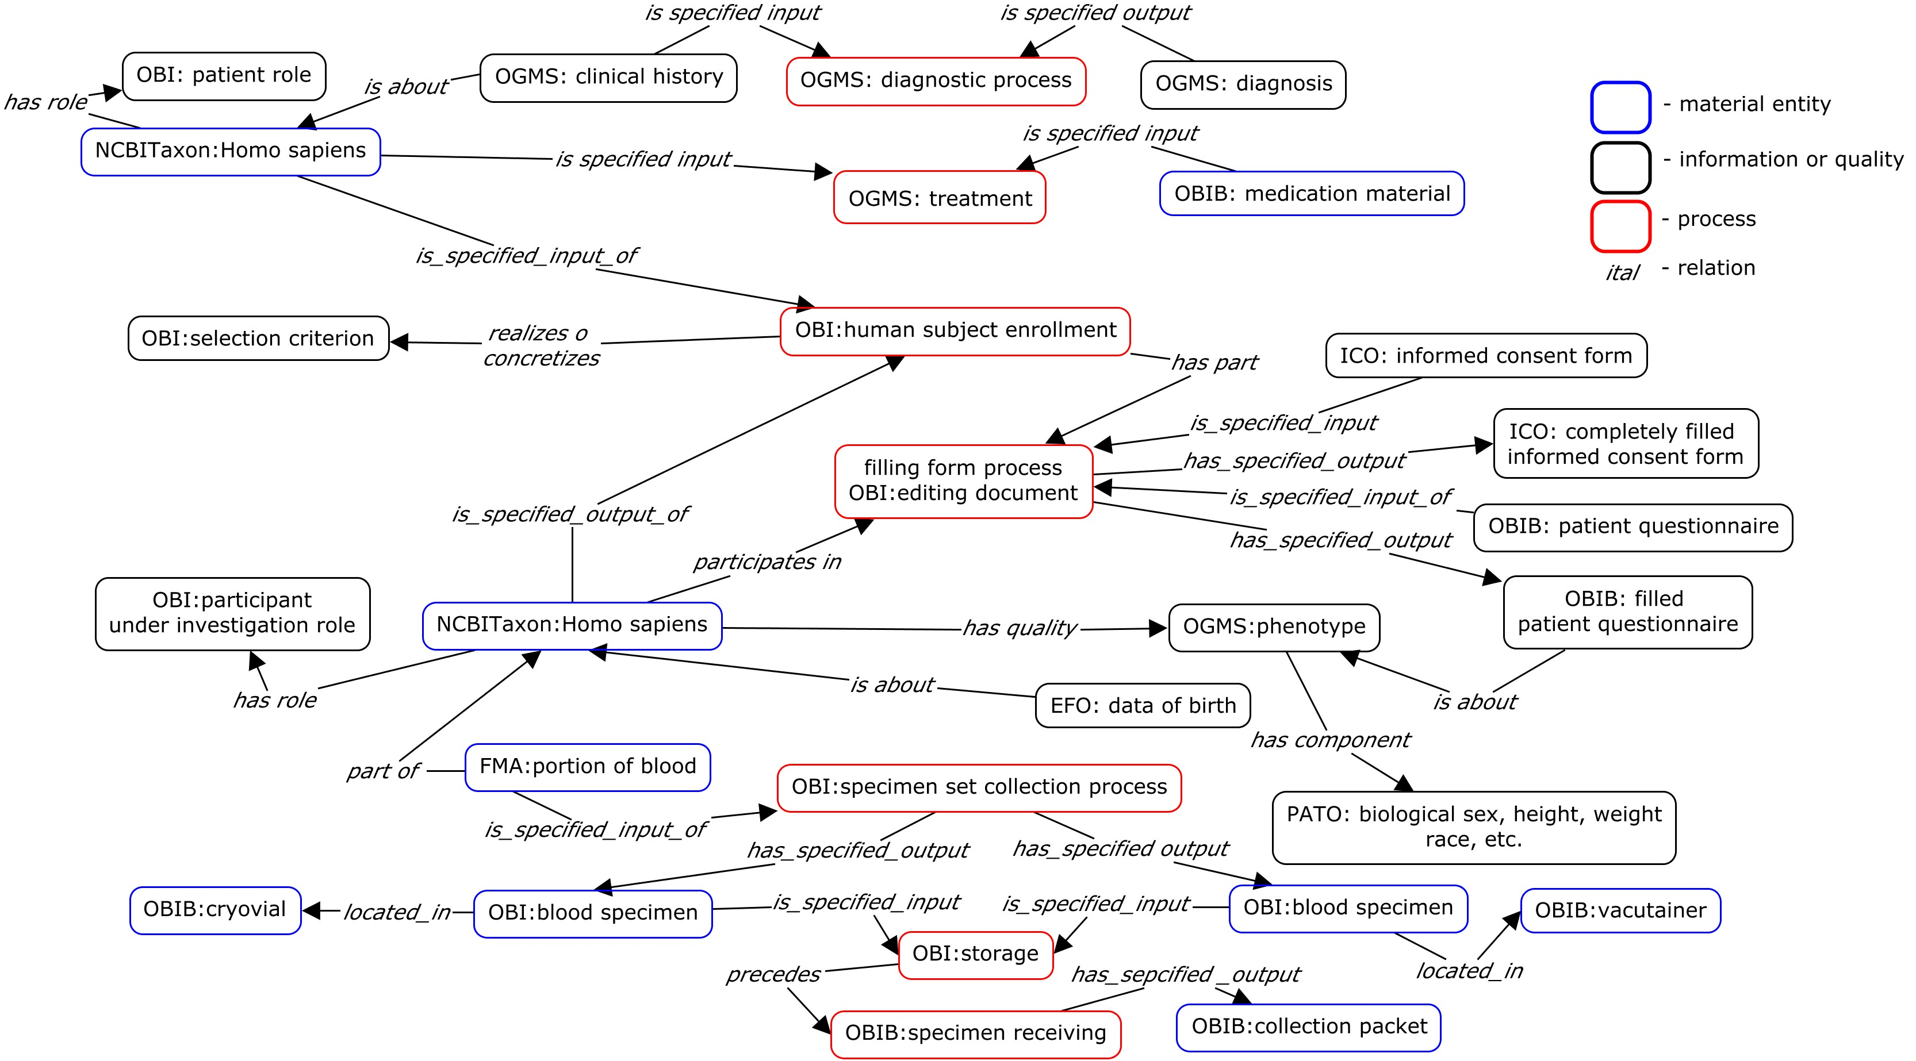
Diagnosis, Consent, Collection, Storage, Distribution Processes
Medical/
Surgical
Procedures
Knowledge
Base
Patient
Acquisition
Handling/
Processing
Storage
Distribution
Scientific
Analysis
PROCESS

Slide 14
Current status of OBIB
Summary statistics for version 2017-11-30
1839 terms (classes and instances) for describing some aspect of biobanking and biobank specimens
77 relationships that connect those terms
Includes coverage of biospecimen pre-analytic variables and GTEx fields from the NCI Biorepository and Biospecimen Research Branch.
Covers HL7 DAM / CDISC use case
New development driven by
Participating institutions (Duke, Michigan, MUSC, NCI BBRB, Penn, UAMS)
MIABIS 2.0 effort (Roxana Merino Martinez, Kaisa Silander, others)
CAP Pre-Analytical variables (Robb et al, 2014)
Issues submitted at https://github.com/biobanking/biobanking/issues

Slide 15
Browsing OBIB
NCBO Bioportal
http://bioportal.bioontology.org/ontologies/OBIB
Ontology Lookup Service
https://www.ebi.ac.uk/ols/ontologies/obib
Ontobee
http://www.ontobee.org/browser/index.php?o=OBIB
Notes:
screen shots of NCBO Bioportal, OLS, Ontobee – more than one place

Slide 16
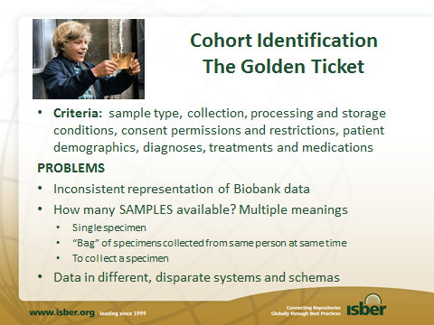
Problems-Ontology Provides Solution
Controlled Vocabulary
Specimen: A material entity that has the specimen role.
specimen family specimens derived from shared ancestor
specimen set specimens collected in one encounter
specimens collected longitudinally: A collection of specimens taken at different time points
Query across disparate systems
Keep existing systems
Add a semantic layer (term mapping)
Map to ontology terms

Slide 17
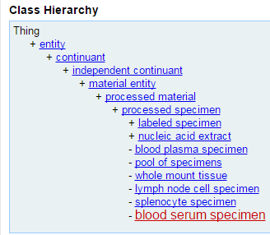
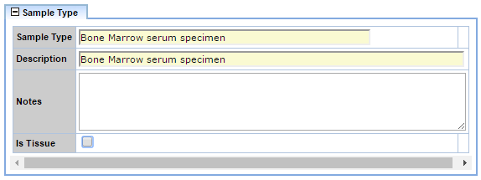
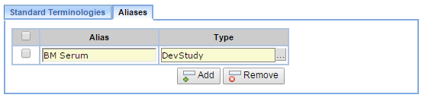
Penn Implementation of LabVantage: Extending Data Models to Capture Ontology References
OBIB Term
- processed specimen
- is_specified_output_of some (((filtration or centrifugation or dialysis)) and (has_specified_input some blood specimen))
- has role some specimen role
Courtesty Ned Haubein, Lead LIMS Architect, PMACS/Enterprise Research Applications

Slide 18
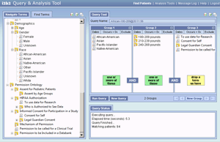


Proposed Implementation at MUSC
Biobank LIMS
Combined clinical & biobank research queries
TST123
TST123
TST123
ontology
Consent Data (REDCAP)
Consent to access EMR
ontology
X
Consent to donate blood
Decline to donate tissue
ETL
Clinical Data Warehouse
ETL
EHR source system(s)
i2b2 mart & client

Slide 19
The Penn TURBO Project is using OBIB for Populating a Graph Database with Biobank Data
1
?
?
?
?
?
4
OBI
DRON
DOID
TURBO Ontology building on OBIB and other OBO Foundry ontologies
Application Ontology
Query
2
R2ML
RDF Conversion
Software
RDF
3
R2RML
RDF Conversion
Software
RDF
Graph Database
Relational
Data
Data from different sources mapped to ontology
OBIB
Ontology for Biobanking
DOID
Disease Ontology
DRON
Drug Ontology
TURBO: Transforming and Unifying Research with Biomedical Ontologies. http://upibi.org/turbo/
Disparate data and Ontologies are
loaded into a graph database.

Slide 20
Take Home Message
Comprehensive biobanking ontology enables searching for specimen collections with associated clinical annotation, within and across systems and institutions
Ontology adds standardized semantic layer to different existing systems, such as LabVantage, LIMS, Redcap, data warehouse
Developing a graph database system to leverage the ontology structure for searches
Provide a framework for collaboration
Extend coverage of OBIB: submit terms and use cases from different biobanks – academia, pharma and vendors
https://github.com/biobanking/biobanking/issues

Slide 21
Acknowledgements
We thank the following for their support of OBIB development.
Leidos subcontract 17X056 to the University of Pennsylvania.
University of Arkansas Medical Sciences Translational Research Institute NIH CTSA grant UL1TR000039.
Duke University Center for AIDS Research NIH grant 5P30 AI064518; Duke University NIH CTSA grant UL1RR024128.
Medical University of South Carolina NIH CTSA grant UL1TR001450.

